Slide 1

Project – 3
COFFEE SALES ANALYSIS

Slide 2



OVERVIEW
To create a dashboard using Power BI to track and analyze Coffee Sales data and generate insights related to purchasing patterns, sales trends, and customer preferences.

Slide 3

PROJECT KEYPOINTS
Data Collection
Data Cleaning & Wrangling
Data Modeling
Data Visualization
Dashboard Design
Sharing Insights

Slide 4

STEPS INVOLVED IN POWER BI
Load Raw Data from Excel/CSV files
Transform Data using Power Query
Report View to analyze data
Table view to modify/manipulate data as per requirements
Model View to establish a relationship between source data

Slide 5
PROJECT LEARNINGS

Slide 6


DETAILS OF DATA
DATE
DATETIME
CARD
MODE
COFFEE
MONEY
6

Slide 7
MAIN KPI’s

Slide 8
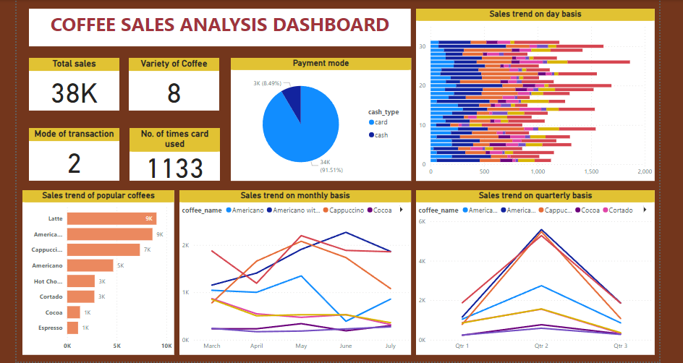
REPORT

Slide 9

INSIGHTS
Total Sales – 38K
Variety of Coffee – 8
Mode of transaction – 2
No. of times payment by card – 1133
Top preference of customers – Latte
Least preference – Cocoa & Espresso
Top sales generating quarter – Q2

Slide 10

Thank you

